Slide 1
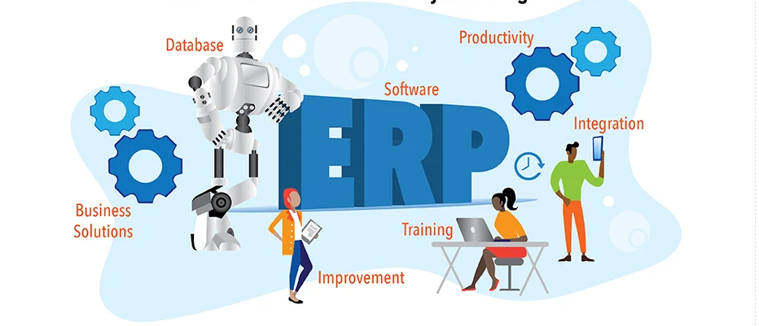
ERP Implementation: A practical Guide
18 June 2024
Notes:
Paul + Laura
What is an ERP + why is it important!
How many people in the audience have done an ERP implementation?
Another Slide?

Slide 2
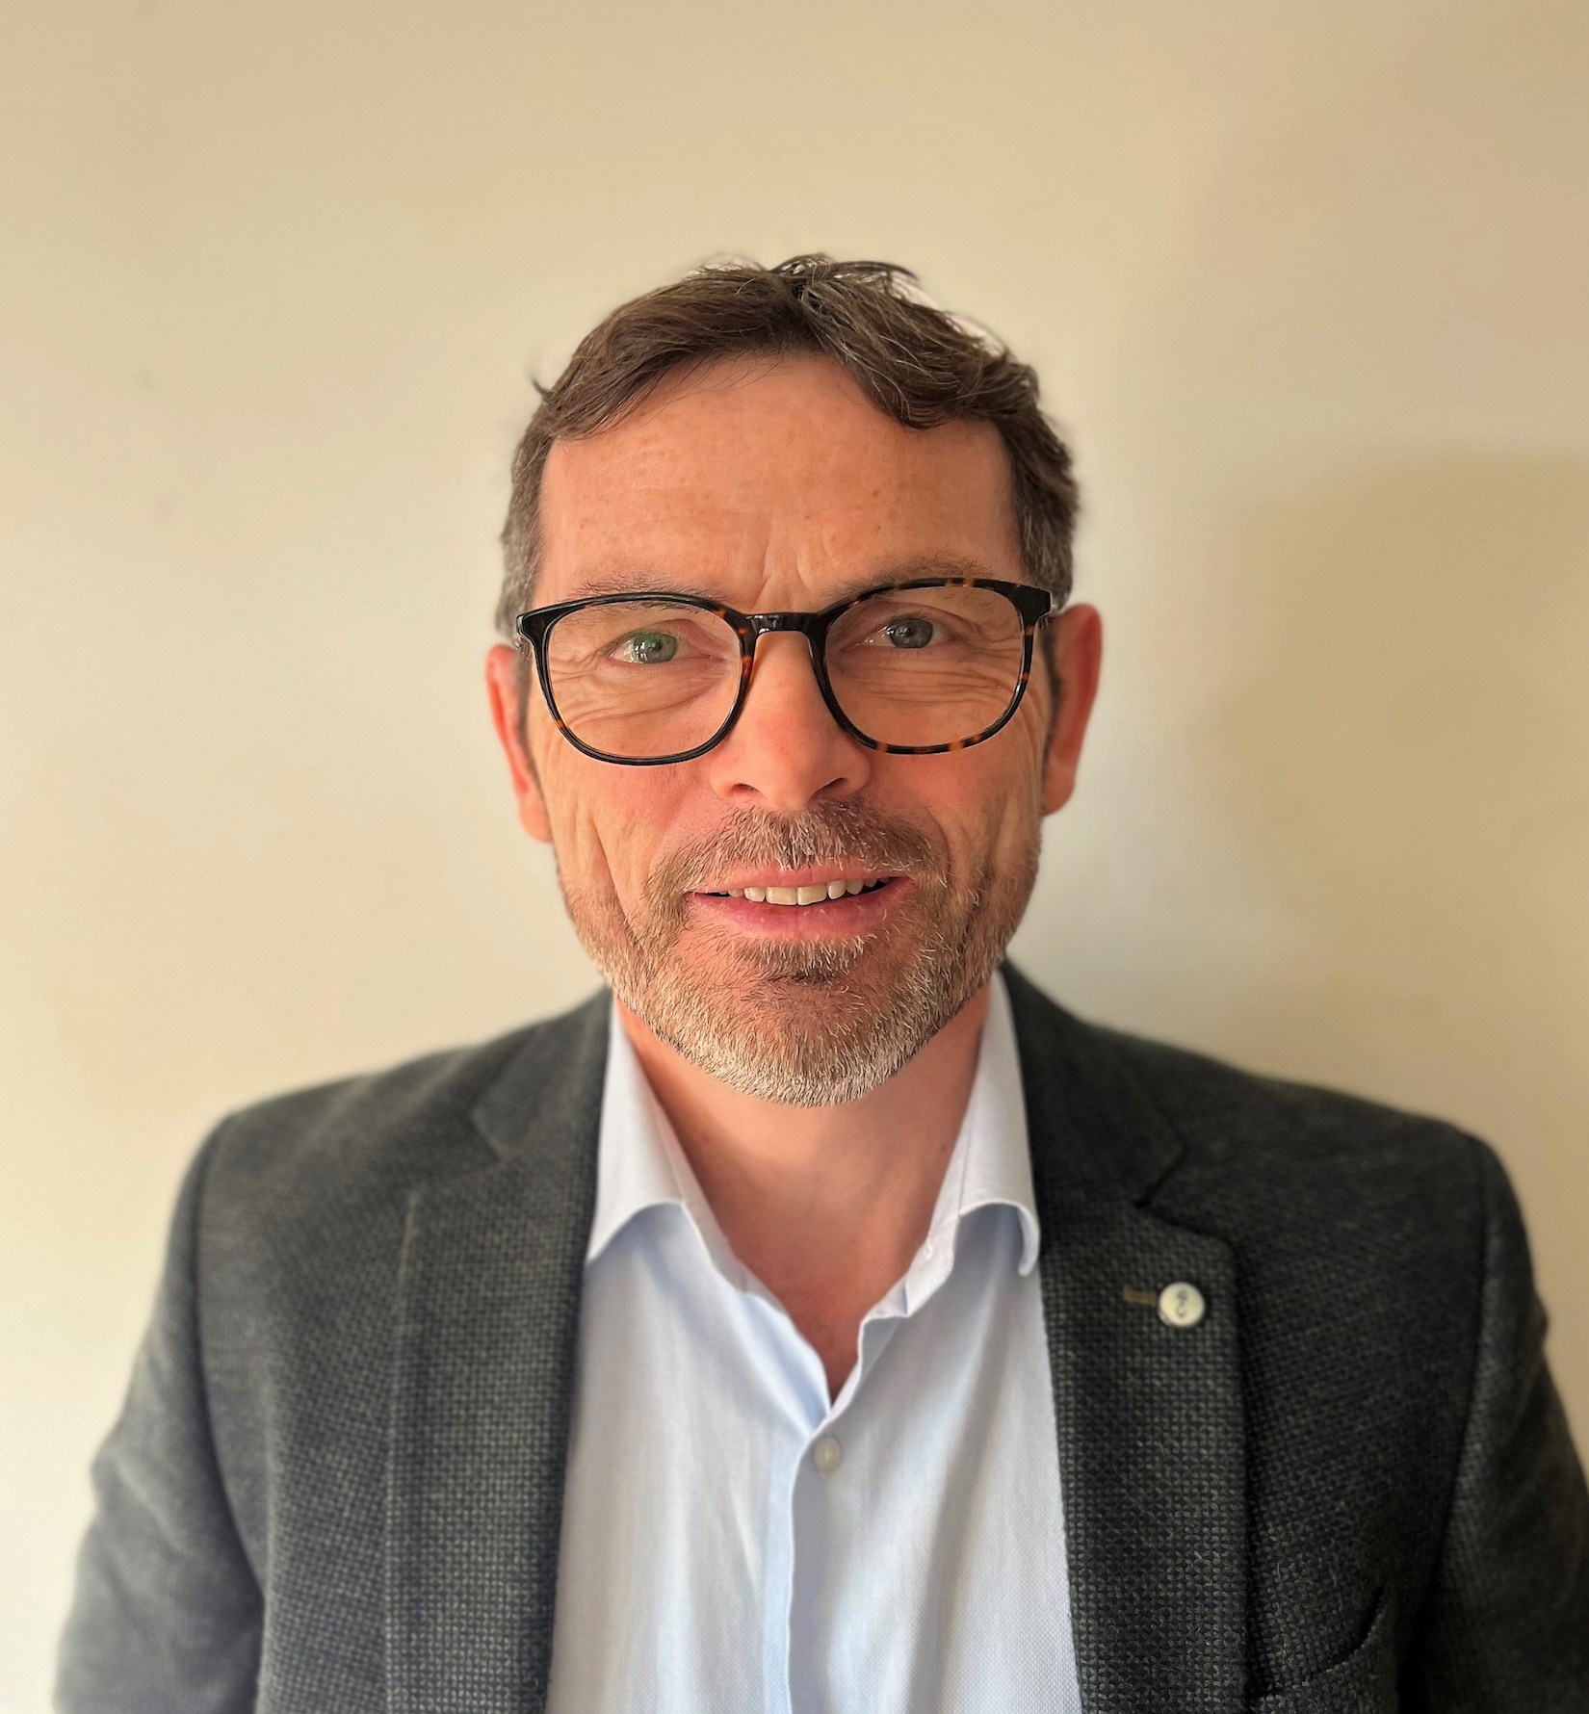
BIO Paul + Laura
Paul Fagan has 35 years of experience in international banking, manufacturing and logistics. Paul has worked in various operational finance roles for over 13 years. For over two decades he has also focused on Project Management, Program Management and Mergers and Acquisitions. Paul is currently working at CEVA Logistics as a PMO Manager in the Data & Digital – BI & Analytics department. Paul is ACMA and a Project Management Professional (PMP).
Laura Roversi has 34 years of work experience of which 12 in Project Management. Prior to that, she worked for 22 years in Finance for General Electric, where she held several financial roles. Her first assignments as project manager were SAP ERP integrations and implementations of enterprise standards in Finance. She currently holds the position of IT PMO for the Veolia WTS business unit. She is Project Management Professional certified (PMP). She is currently a Board Member of the PMI Dutch Chapter in the function of Treasurer.
Notes:
Paul

Slide 3
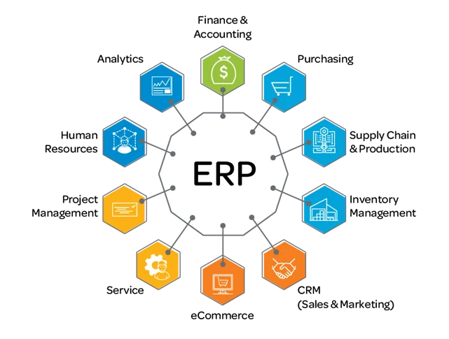
What is an ERP and why is it important
Enterprise resource planning (ERP) is usually referred to as a category of business management software—typically a suite of integrated applications—that an organization can use to collect, store, manage and interpret data from many business activities.
Notes:
Laura

Slide 4
SUMMARY
01 Lessons learnt
02 Building a team
03 Governance
04 PLanning & Communication
05 ERP Roadmap Transition
06 Testing - Go-Live - Hypercare - Lessons Learnt
07 Q&A
Notes:
Paul

Slide 5
Generally, we will all encounter that ‘once in a lifetime’ project:
This can be brought about by the need for a
New ERP Implementation.
New financial system.
A merger or divestment.
Take control and make that
‘once in a lifetime experience’
a great one!
Notes:
Paul

Slide 6
HOW TO LEVERAGE PAST EXPERIENCE

Slide 7
Applying Lessons Learnt
Before starting a new ERP project, it is advisable to retrieve the lessons learnt from previous projects.
Aims:
Avoid previous pitfalls of other similar projects.
Learn from also ‘what worked well’.
Notes:
Paul

Slide 8
Examples & Best Practices
Key Lessons Learned Best Practices
Local leadership support - a must Standard operating procedures
Governance and communications are key Plan, Plan, Plan
Training, training, training Training and UAT driven by process maps
Rationalize and cleanse data Financial cutover reconciliation (old vs new ERP)
Adoption and sustainability To be organization structure available
Consider all connected systems Clear requirements
Notes:
Laura – Examples of ERP Failures = ABB Brazil ERP failure

Slide 9
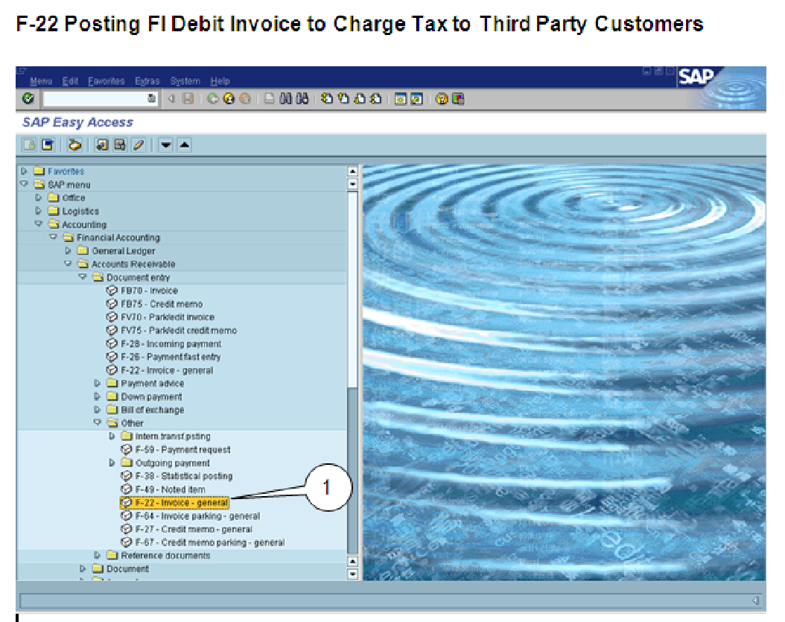
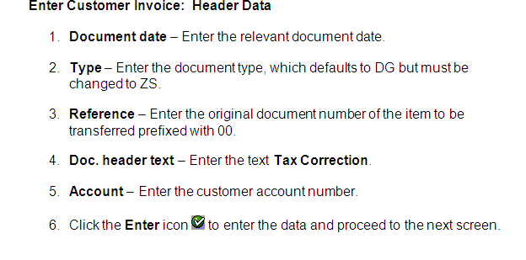
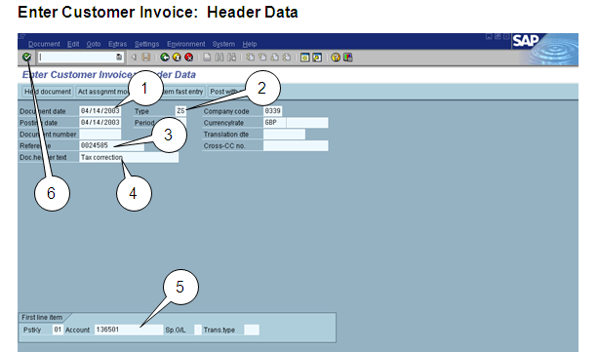
Process Maps
Key Strokes
Train
Test
Process Map
Notes:
Laura

Slide 10
BUILDING A TEAM

Slide 11
Project Initiation How to build an ERP team
Start with a qualified Project Management Professional internal Project Manager.
Choose an experienced PM with a track record.
Ideally, your PM should be independent of your supplier and/or partners.
Consider an internal PM (if qualified/experienced enough) and/or independent external.
Build a PMO (Project Management Office) team.
The PM needs to manage the workstream leads, supported by the PMO. It depends …
Workstream team with leads
Evaluate internal staffing needs v external staffing needs.
Working with a supplier, use fixed contracts, based on scope of work.
Notes:
Larua -
PMO … It Depends Laura - experience / Paul – PMO Experiences. Backfills
Worksteam?

Slide 12
Workstreams with concrete deliverables
Workstreams are especially used in larger ERP projects to define concrete deliverables per workstream function.
Examples:
R2R : CoA / Account mapping / reports / budget
P2P: workflow / thresholds / aged reporting
O2C: overdues / specification for top 10 reporting
Breaking down a very large project into its component parts by function & ensuring that the right subject matter experts are assigned.
Notes:
Paul

Slide 13
Workstreams Org
Steering Committee
Finance
ITO/OTR
Staff Sponsor
Supply Chain
Procurement
Program Manager
Project Manager
Local Team Lead
Core Team
Integration Core Team
Integration Core GPO’s
Coach/ SME
Sourcing/Vendors
Customer Services
Manufacturing/Warehouse/Logistics
Sourcing/Vendors
Warehousing/Logistics
Material Master ES
Sourcing/Vendors
Material Mast.- ES
ITO / OTR
Finance
Projects
Finance
Planning, Manu./Inventory
Customer Services
Customer Services
Planning, Manufacturing
Tax
Projects
ITO / OTR
A/R
A/P
Intercompany
Fixed Assets
Treasury
FPA Reporting
Technical: Internal or external?
GL & T&E
As-Is
Accountable
To-Be
Accountable
The Bridge
System Config./Data Conversion/Testing/Training
Responsible
Notes:
Laura - One Global ERP implies one process\. Examples: attaching invoices / No PO no pay / Localizations.
Paul – Global process owners … Size + Magnitude

Slide 14
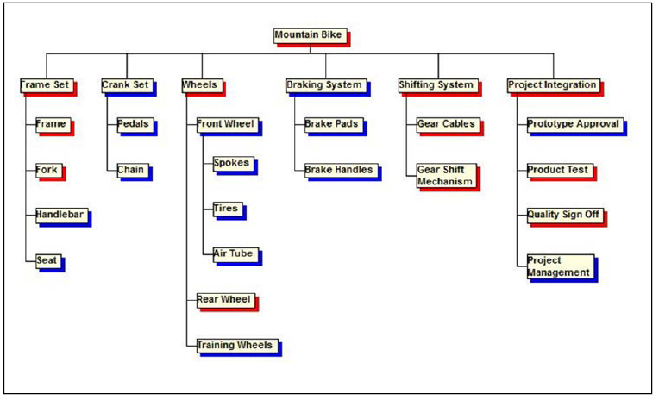
Workstream - Converting to results
RACI : Ensure that you have ‘Workstreams’ with defined roles and responsibilities (R&R) = RACI Model.
WBS : Work breakdown structure (WBS) assigns further to team members deliverables.
Having defined roles and assigned deliverables gives:
Ownership.
Clarity on delivery.
Accountability.
‘Work Stream Leader’ role is to ensure workstream deliverables.
Workstream interdependencies can be identified
Notes:
Paul

Slide 15
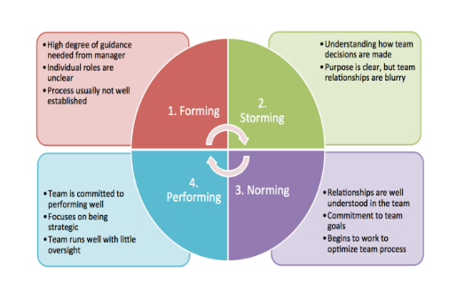
Team Development Bruce Tuckman 1965
Role of the PM is to guide project members through each phase of the project lifecycle.
A different management approach is required per phase:
Forming – utilize informal leaders,
encourage observers, support new/struggling team members.
Storming – let ideas flow.
Norming – concrete deliverables.
Performing – the goal!
Notes:
Paul

Slide 16
GOVERNANCE

Slide 17
ERP Project Governance
Project Charter
or
Project Initiation Document (PID)
+ Business Case
Shareholders
Articles of Association
Supervisory Board
Regulations of the Supervisory Board
Charter of the Audit Committee
Charter of the Remuneration Committee
Charter of the Sustainability Committee
Sponsor
Steering Committee
Change Board
(Roles & Responsibilities)
Managing Board
Regulations of the Managing Board
Project Manager + PMO
Units
Management Framework
Code of Business Conduct
Corporate Requirements & Directives
Workstreams + WBS
Roles & Responsibilities
Project Management Guidelines
Corporate Governance: Legal, rules, system, firms are managed + controlled.
Project Governance: Objectives, means to achieve, methodologies, policy + rules.
Notes:
Paul Executive sponsorship is a must! Steering committee that represents the business & each workstream Steering committee should be separate to the implementation team ( to maintain the helicopter view).Manage your key stakeholders separately – steeco pre-chats / Timely information - always send your Steeco Pack 48 hours before hand Business case - ensure thta you have a solid business case.

Slide 18
Governance Translating strategy into deliverables
The PM and/or PMO should ensure:
Meeting cadence to ensure project control and deliverables:
Defined roles & responsibilities of each body, examples:
Sponsor : provide funding and overall sponsorship.
Change Board: guard the scope.
Steering Committee: decide if the project can pass to the next gate.
Workstreams: ensure the deliverables.
Corporate
Governance
Project
Governance
Delivery
Capability
13 June 2023
Notes:
Paul Tax authorities – want invoicing sequentially / document numbering also in sequence / EDI connections

Slide 19
PLANNING + COMMUNICATION

Slide 20
Waterfall
Project Processes/Phases
End
Start
Closing
Cost
Time
Quality
Monitor and Control
Progress
Change
Cost
Time
Execution
Communication
Risk
Quality
Project Definition and Planning
Project Plan
Detailed Plan
Procurement
Cost
Pre-Project Phase
Initiation
Stakeholders
Resources
Scope
Budget
Communication
A Reminder
Notes:
Laura ERP projects require a ‘full gate model / waterfall approach’. the overall project is NOT suitable for agile, certain parts maybe.

Slide 21
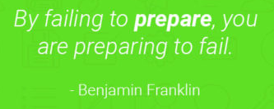
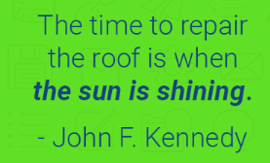
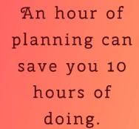
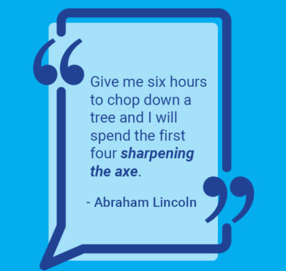
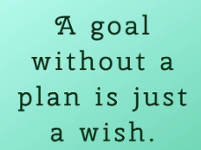
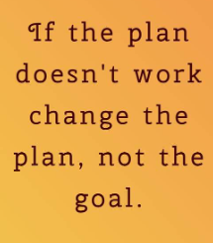
Plan, plan + Plan!
Notes:
Laura ERP projects require a ‘full gate model / waterfall approach’. the overall project is NOT suitable for agile, certain parts maybe.

Slide 22
Plan, plan - Plan!
Master ERP Plan
A single plan that recognizes the interdependencies.
“A Project Manager should spend 60% of their time planning & the rest communicating”.
Multiple tools available but you will most likely need:
An executive summary for sharing with your steering committee and senior stakeholders
A detailed plan with interdependencies that goes right down to work breakdown structure (WBS).
Be vigilant as there is a tendency for everyone to maintain their own planning.
Some large ERP projects have full time planners in the PMO office.
Ensure that you identify pre-requisites / interdependencies … 1m open items in the sub-ledger
Plan for Architectural / Landscape needs: a ‘Three Tier Landscape + Parallel Landscape’.
Notes:
Paul

Slide 23
Planning - Communication
Communication plan
The key to communication ‘Get the right information to the right people’ the way they want it.
Communication plan should include both internal and external stakeholders.
Your Project Manager should practice :
‘Active Listening’
Ladder of inquiry - 7 Whys
Level 2 communication - See PAiE March Event !
A multi-media approach, consider a monthly newsletter. … watch out for overload.
Consider a full time communication or change manager in your team.
Prepare detailed ‘Black out plan’ for ERP transitions.
Establish dedicated communication channels for ERP Hypercare.
Remember, ERP transformation is a journey and you need to involve your users and to guide them through this journey.
Notes:
Paul ERP projects require a ‘full gate model / waterfall approach’. the overall project is NOT suitable for agile, certain parts maybe.

Slide 24
ERP Roadmap
Transition

Slide 25
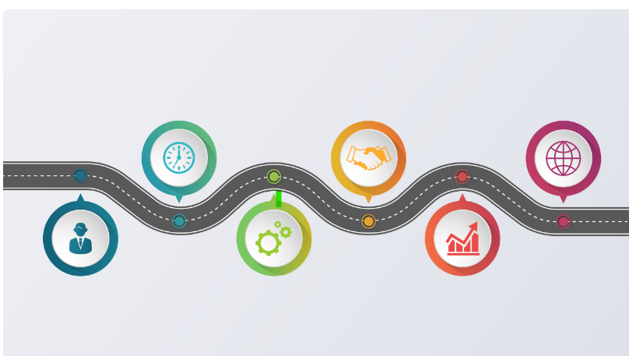
ERP Roadmap + Change Management
ERP ROADMAP
Discovery phase: “As-IS” to “To-Be” = Plan = Agreed scope.
Minimize customization: (part of business case) + use standard functionality.
Strong ‘Change Board approach’:
Challenge processes (simplify processes).
People want to keep ‘as-is’ + extensive change management.
This can be a Critical success factor.
Use a ‘hard cutover’ with no parallel runs.
Use industry solutions: SAP / Oracle / JDE have solutions per industry.
Commit to ERP enhancements from the minimal viable product to give ‘line of sight’.
Notes:
Laura

Slide 26
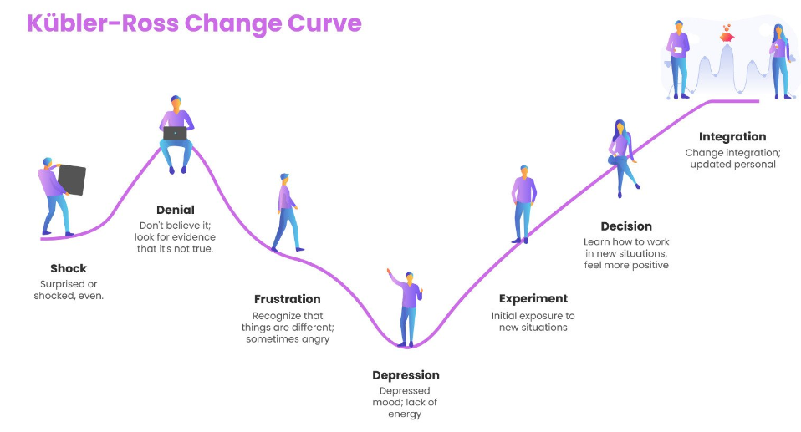
ERP Roadmap + Change Management
CHANGE Management
Understand and manage people through the ‘Change Management Lifecycle’ .
Future support Plan the handover to the future ownership model, use roles and responsibilities R&R matrix.
Adoption: the level of adoption can really impact the success of the project. Consider how likely is it that you recommend this system to a colleague.
Promotors: find the promotors, to help others feel psychologically safe.
Celebrate success and the quick wins.
Train your users early on basic navigation, tips and tricks
Train to perform - users need to be trained before UAT starts.
Demo the system and expose your key users to the system and new features
Aim to ‘Satisfy’
Ensure ‘Performance’
‘Happy’ users
Notes:
Paul

Slide 27
TESTING + GO-LIVE + HYPERCARE
Notes:
Speaker: Yolanda introduction and hand over to directors

Slide 28
Testing - Go-Live - Hypercare - Lessons Learnt
TESTING - Before Go-live:
Test, test and test again!
Make a test plan.
Ensure unit, integration, UAT, stress testing, performance testing + evidence.
Plan contingency in your UAT (official UAT time period + 2 weeks).
Confirmed UAT resources.
UAT sign off by Process Owners!!!
ERP Go-live week end(s) and/or Phased Go-Live
Cutover plan.
Freeze periods – shutting down early / no more transactional business.
Golden transactions (production, logistical, EDI, financial etc.)
Monitoring core operational processes.
Check point meetings + Go / no-go with the steering committee + Roll back plan’
Use your accountants - Full reconciliation
Balance sheet / P&L / Trial Balance / Inventory / Cash
Before and after!
HYPERCARE
Hypercare – have the team on standby (reactive measures).
Hypercare issue log + Q&A.
Proactive measures – check ins / refresher training sessions can avoid/preempt many challenges.
LESSONS LEARNT
Closing meeting with team + stakeholders.
Finish with lessons learnt!
Notes:
Paul

Slide 29
Q&A

Slide 30
THANK YOU!

